Slide 1
WEB PROGRAMMING TRAiNING
BY
A.D. Adekale,
Ja’afar Sadiq,
Muhammed B. Ibrahim,
Erasmus E. Obeth

Slide 2
Day 8 HTML AND CSS
STYLING AND DESIGNING YOUR WEBSITE ELEMENTS AND LAYOUTS
We've looked at HTML and CSS basics, Now it's time to look at
How to Style and Manipulate the Contents( (Texts, Elements, Boxes, containers) that your content sits inside.
How to correctly arrange your boxes in relation to one another and the screen (viewport).
So as to make our day 6 Media gallery look much more nicer

Slide 3
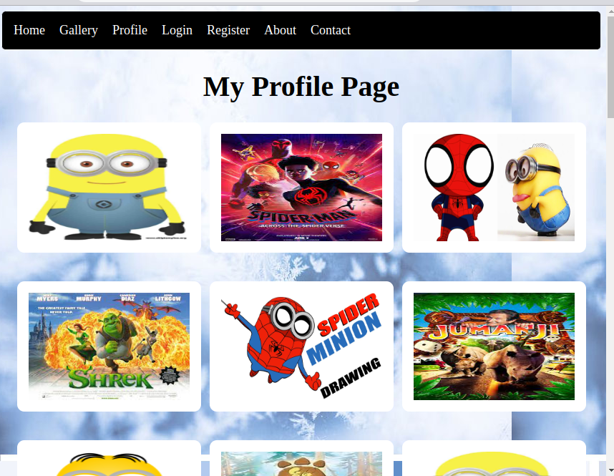
WHAT WE WILL BE DOING TODAY

Slide 4
COMMON WAY TO LAYOUT YOUR PAGE CONTENTS
There are html elemets that help your group and give meaning to your webpage such as nav, header, footer, div, span, main, aside
We will be using the nav header div and footer elements to make our styling more easier of our day 6 project.
<header> </header> to contain our logo and navigation bar.
<nav> </nav> to contain our links to other webpages.
<div></div>, <span></span>, <main></main>, <aside><aside> to hold contents we want to group together
<footer> </footer> to hold our less related and links.

Slide 5
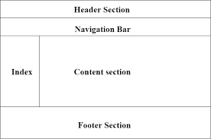
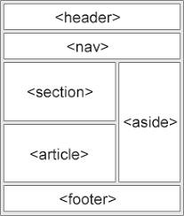
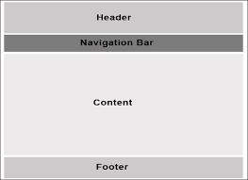
Example of page layouts

Slide 6
Arranging and Placing your contents (elements, box, containers) using CSS 1
You can arrange and display your contents (elements,box,containers) with css in different ways like;
Inline display: inline;
To put your elements in a line one after the other like a school assembly line.
Block display:block ;
To put each element in its own line just like blocks untop of each other in a building.

Slide 7
Arranging and Placing your contents (elements, box, containers) using CSS 1
Flex display:flex ;
To put contents or elements in 1 direction in a container and more advance make your content shrink grow fill and resize based on certain values.
Grid display:grid ;
To put elements or contents in rows and columns.
There also other types of displays used for specific situations

Slide 8
Placing things CSS Positioning
To place contents (elements tags, box or containers) on any part of the screen or viewport we use the css property position:value and the value can be,
Fixed position:fixed
To fix the container box or element permantly to the screen even when scrolling, It doesnt move the content with the rest of the page.
STICKY position:sticky
Makes the element or container stick to the screen when scrolling away from it just like a sticky glue.
Other position types are Absolute and

Slide 9
Making your contents to fit the same in differents screen size
CSS Units
Apart from the px to specify size measurments.
Other measurements unit can also be used and they make our websites more responsive and fit the same across differents screen sizes.
Examples are cm, mm, pt, em, rem, vh, vw, %

Slide 10
When things are not working the way you want them to!!!!
Errors and solving them (debugging)
Cross Check and correct your HTML and CSS for any missing or dyuplicated syntax opening or closing tags or symbols,
You did not saved your file
You did not open the correct file location
You wrote incorrect html elements
You wrote incorrect css syntax
You are not selecting the right element, class or id
You can open the developers tool in your browser menu bar or panel to directly see how it is seeing the file you ask it to display and the corresponding style it applied to the element

Slide 11
Learn More About HTML AND CSS
Visit this website:
https://www.w3schools.com/

